Slide 1
Keyboard Efficiency
Escaping the Mouse Trap and Taking ctrl.

Slide 2
Keyboard Shortcuts are Key
Unix keyboard shortcuts are almost universal across apps and programs.
Unix shortcuts activate through the ctrl key.
Combined with Mac shortcuts all workspaces, files, apps, programs and web searches are directly accessible via the keyboard.
Tmux – Terminal multiplier enables terminal multitasking.
Linux Commands.
Useful applications for Macbook.

Slide 3
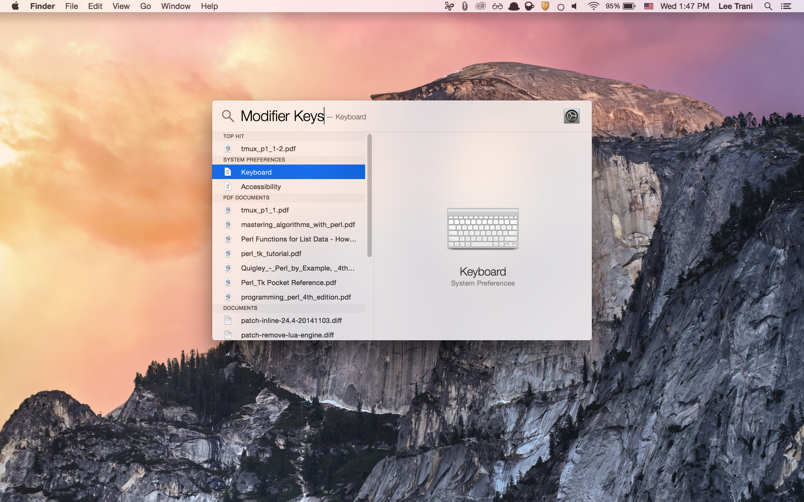
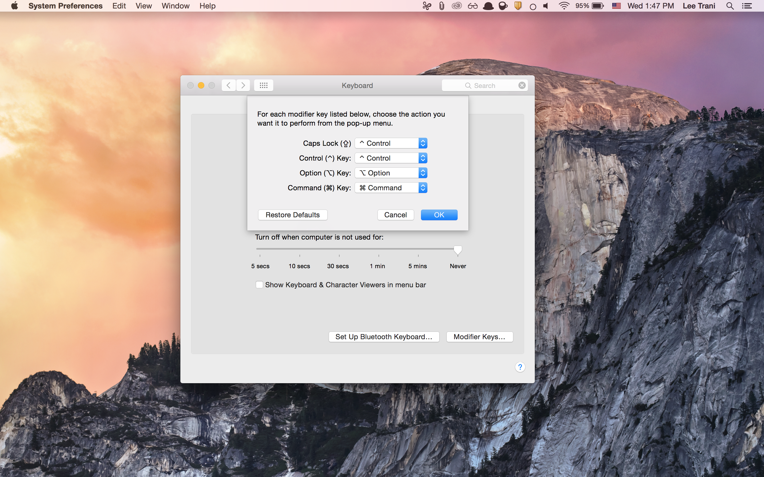
There’s An Easier Way
[cmd][Q] - quit
[cmd][space]
Type: Modifier Keys
Select Caps Lock, change it to ctrl

Slide 4
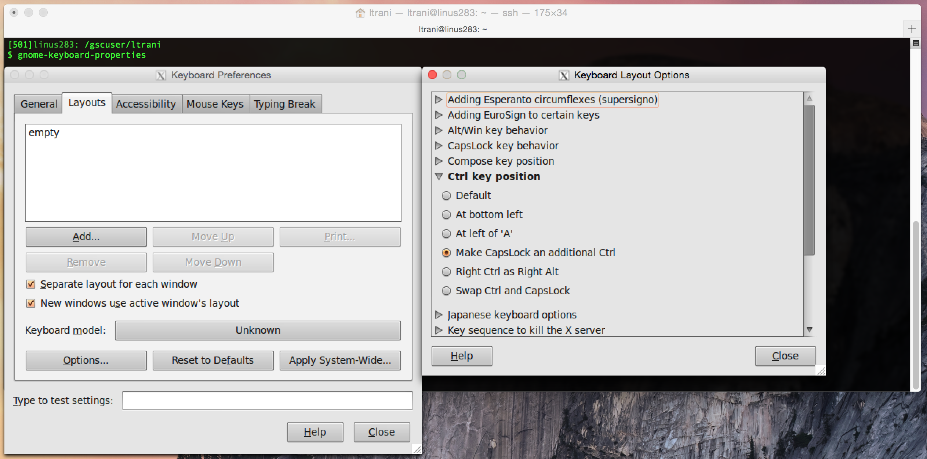
Unix Ctrl Key Position Modifier
gnome-keyboard-properties

Slide 5
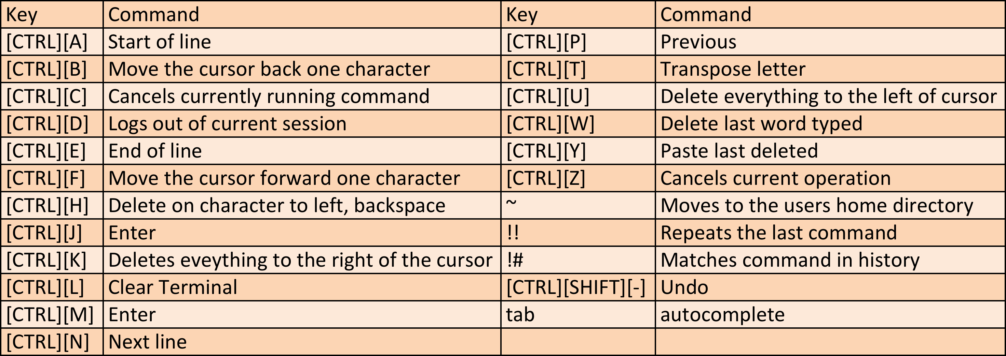
Unix Shortcut Keys

Slide 6
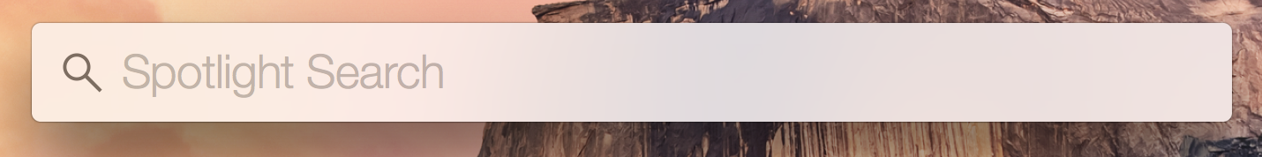
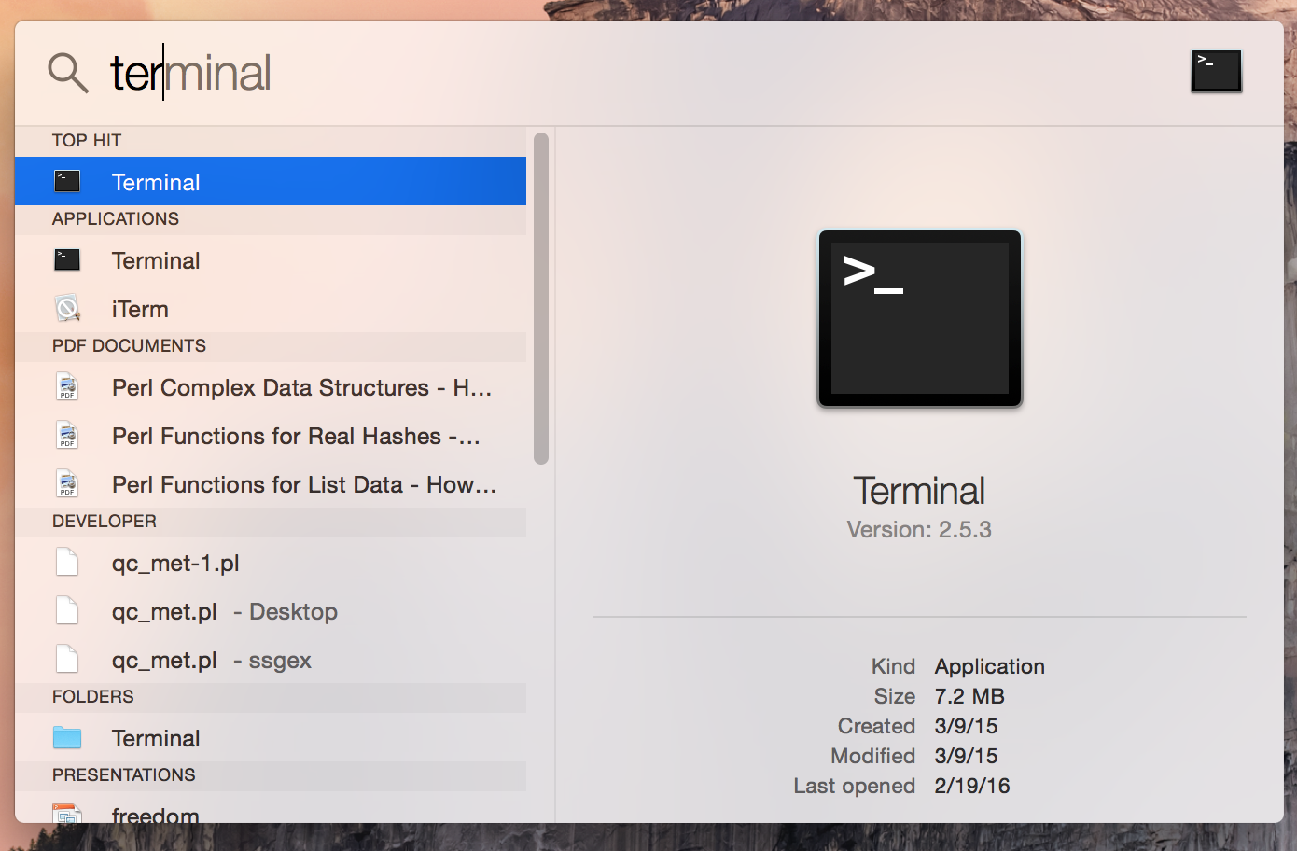
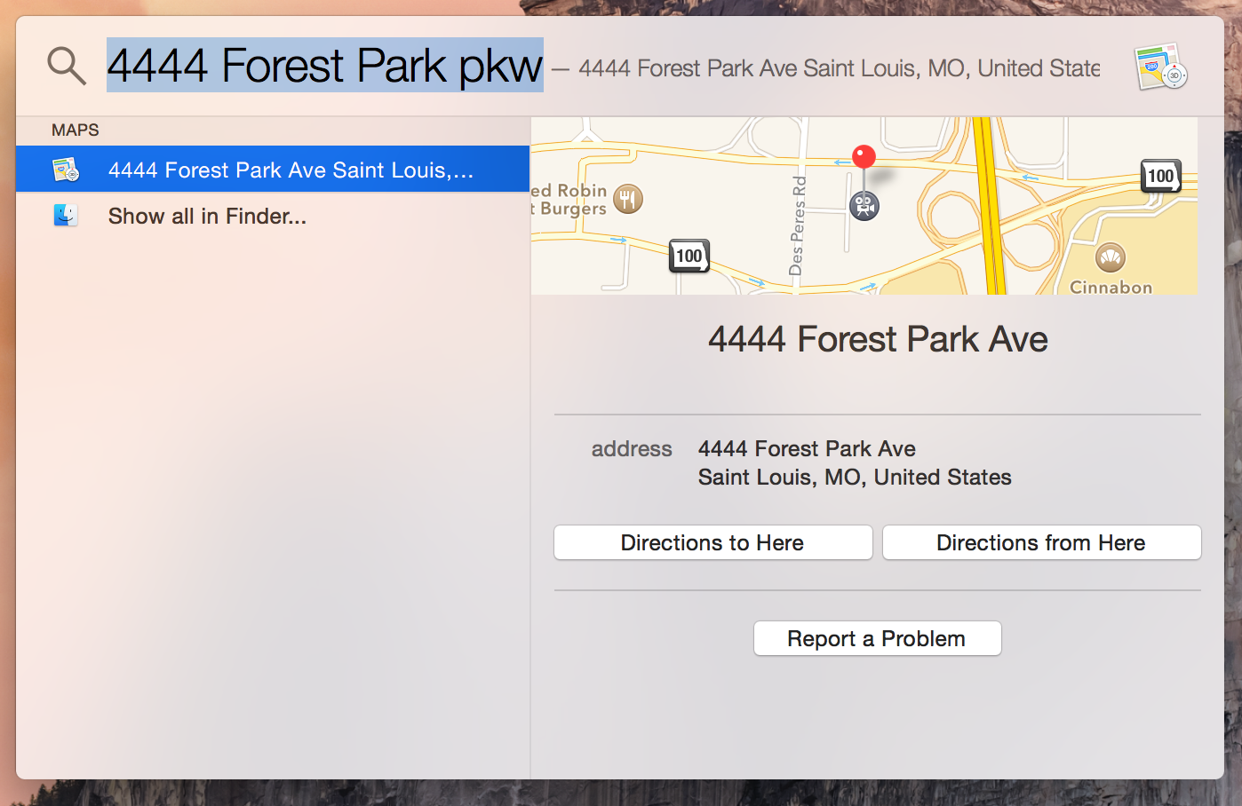
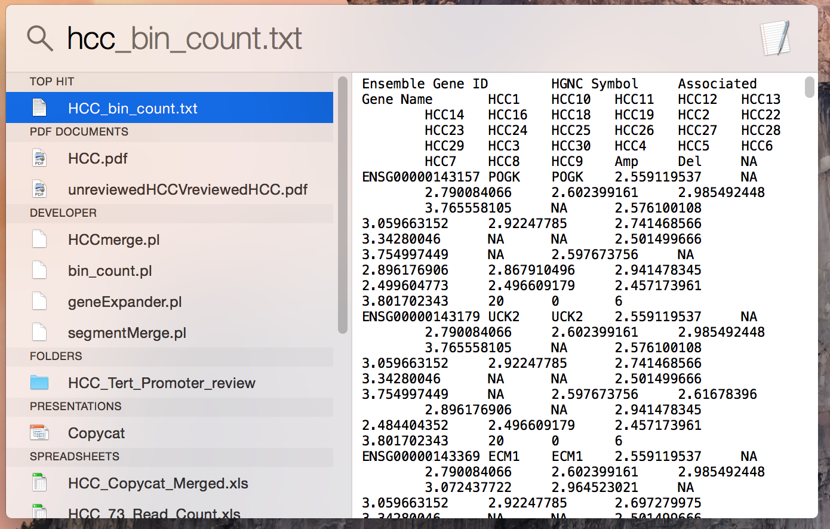
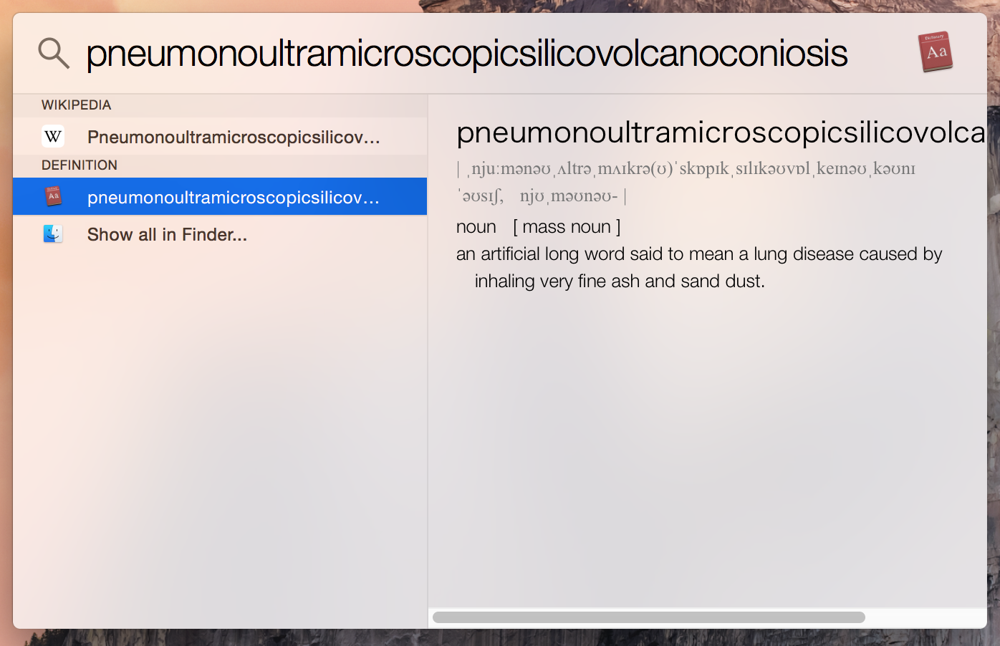
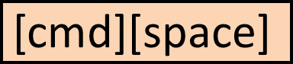
Spotlight
Notes:
Calculator

Slide 7
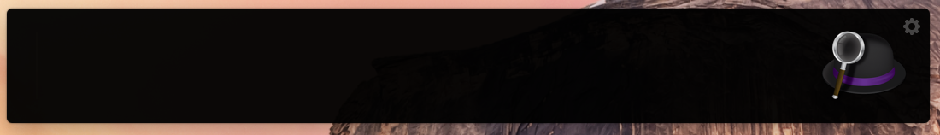
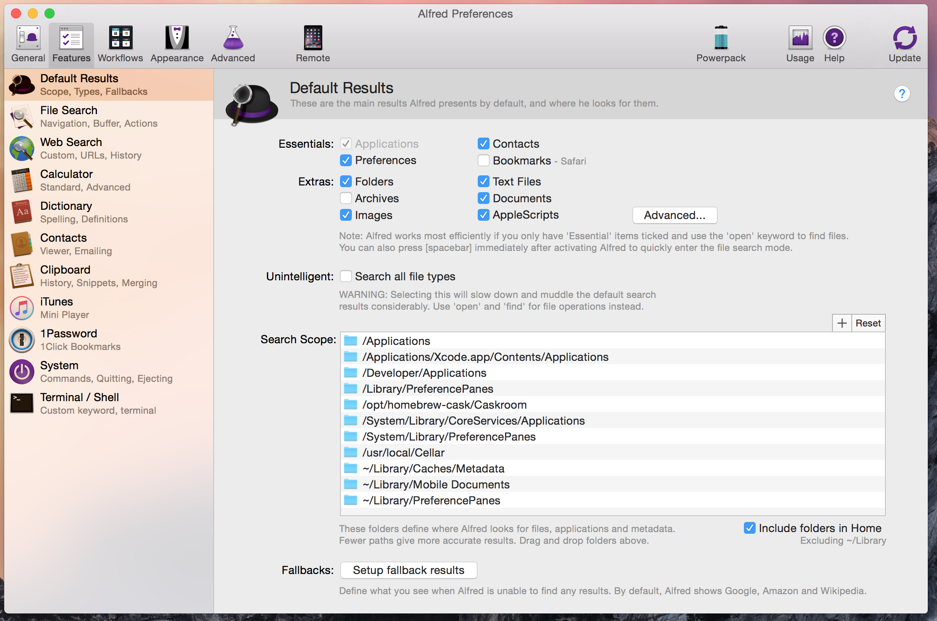
Alfred

Slide 8
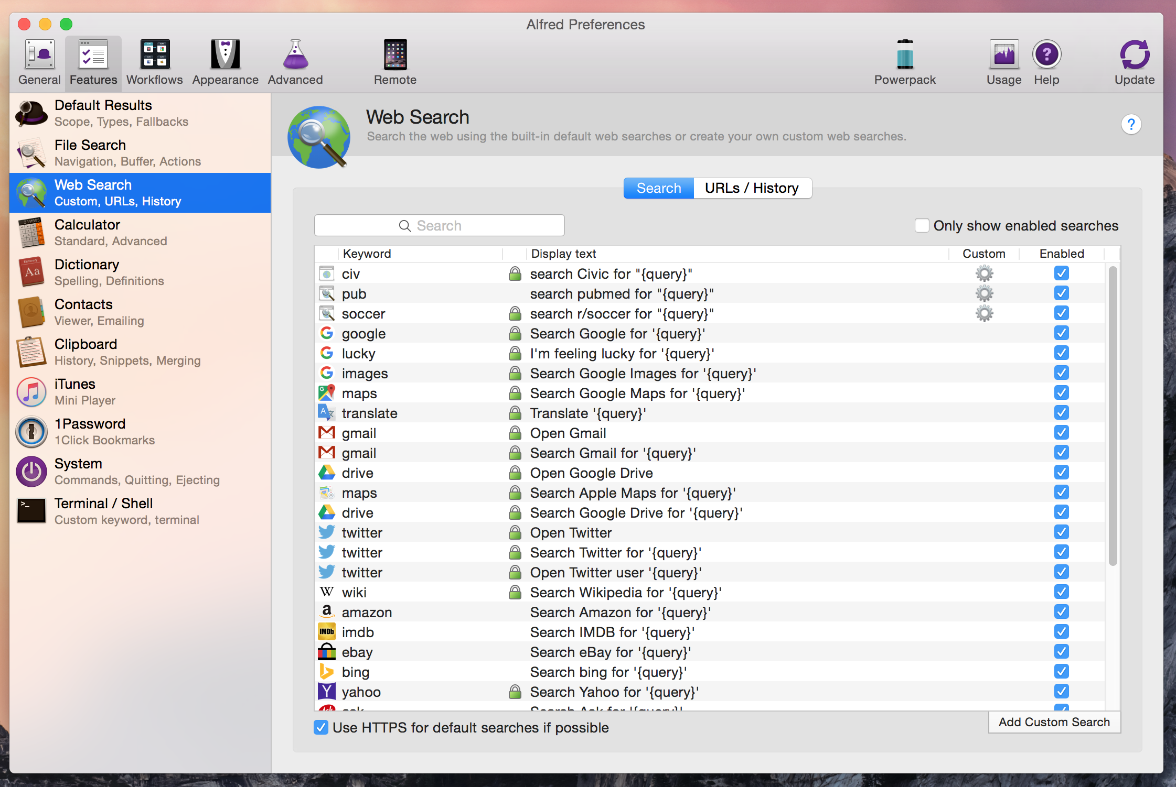
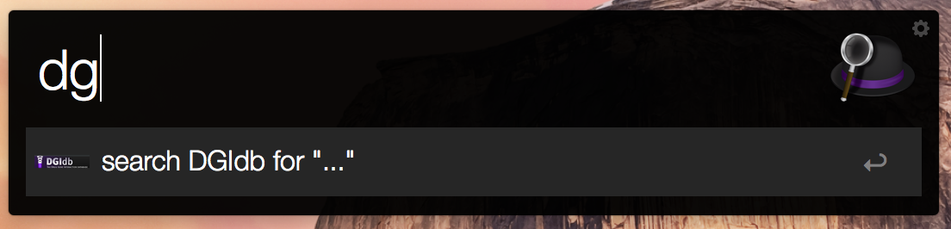
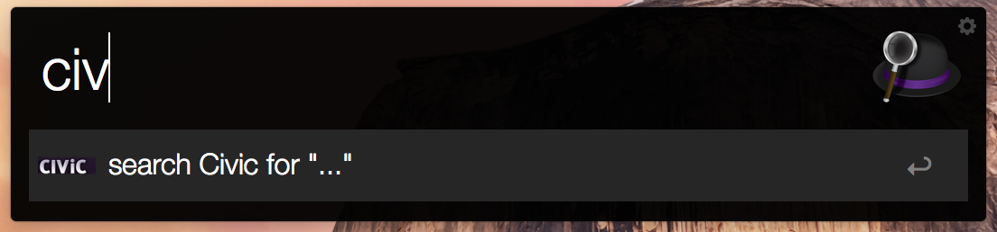

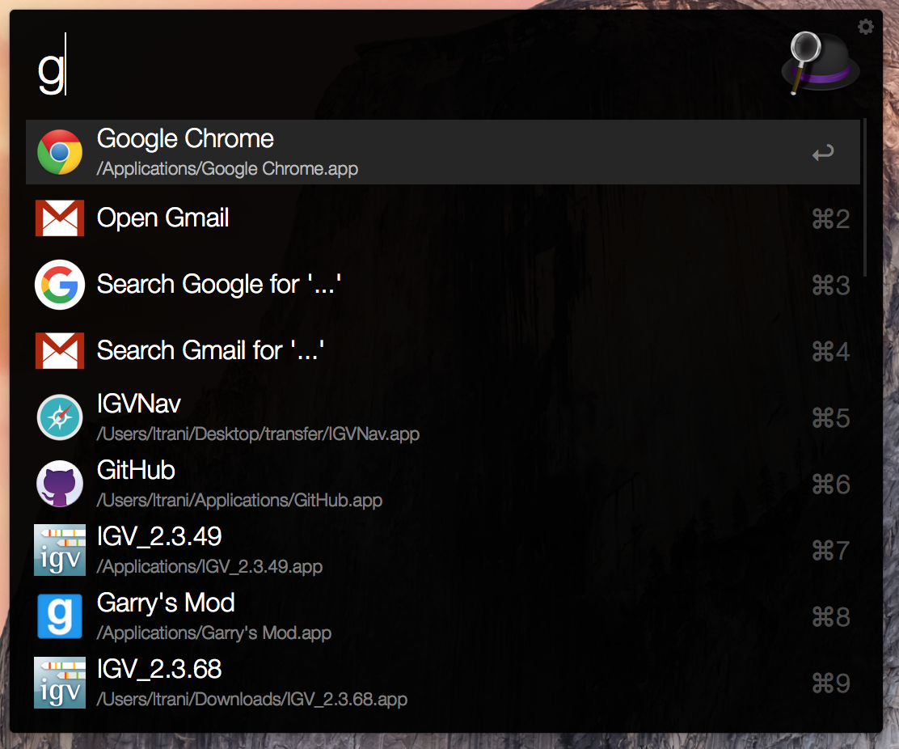
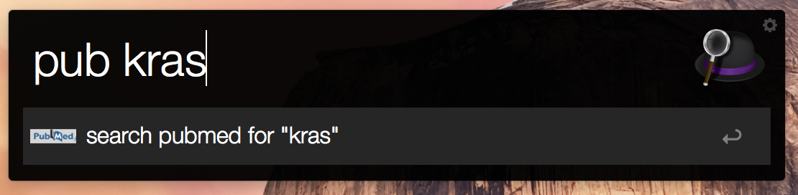
Alfred Web Search

Slide 9
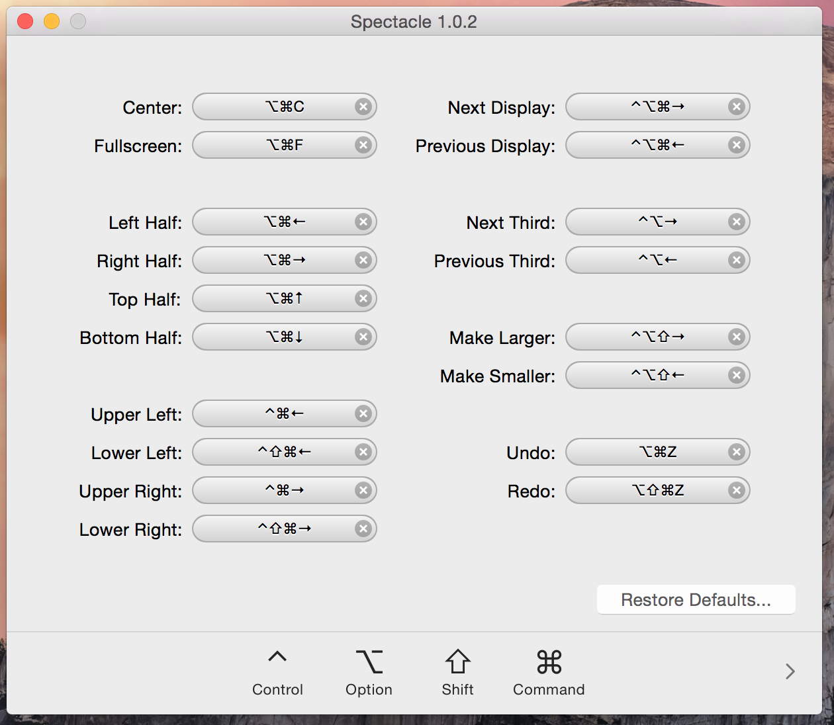
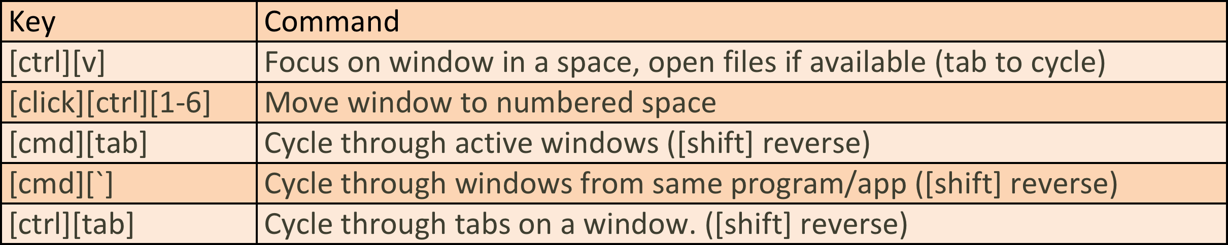
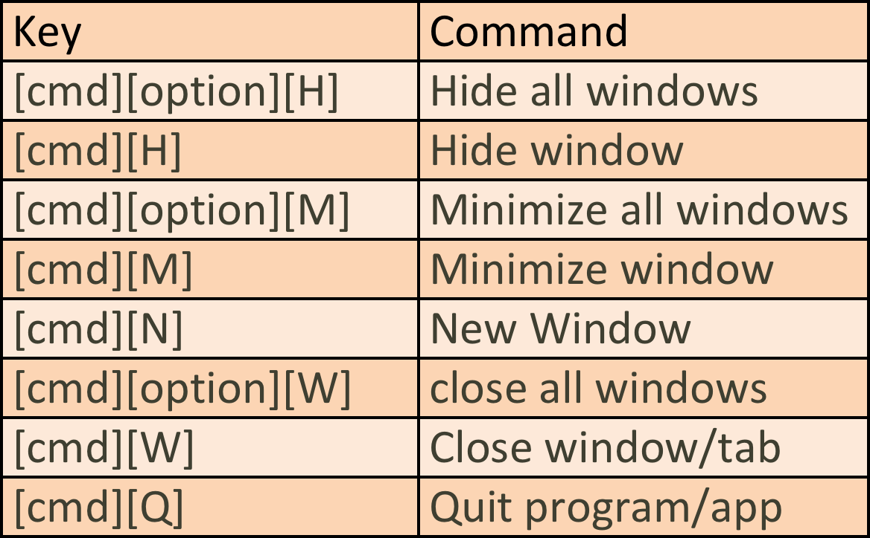
Window Management

Slide 10
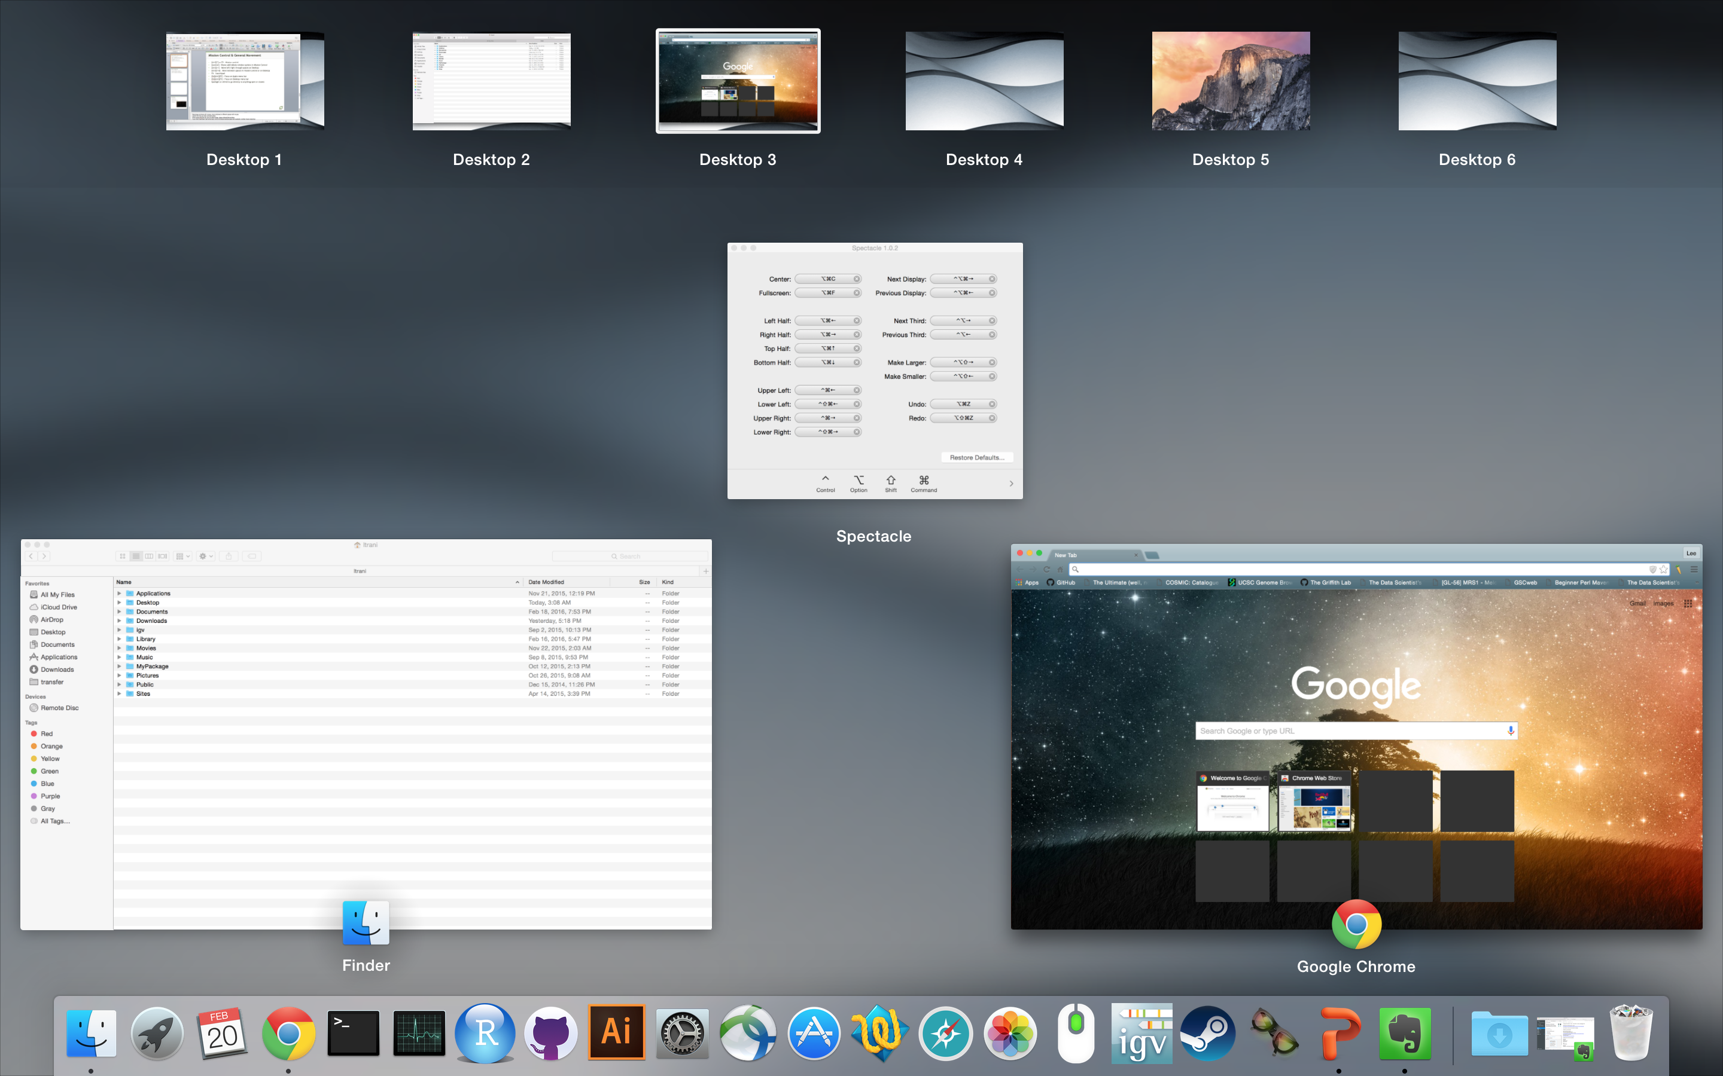
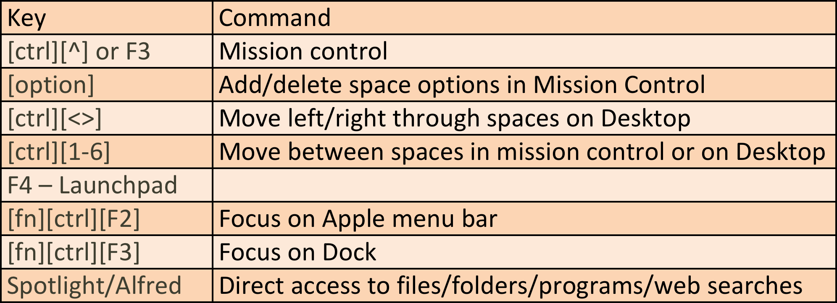
Mission Control & General Movement

Slide 11
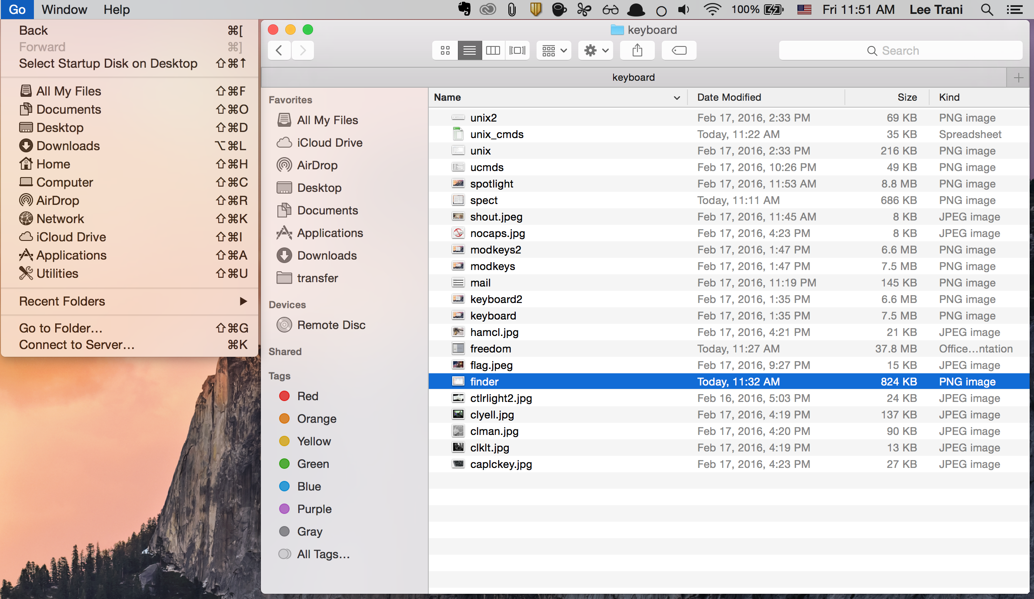
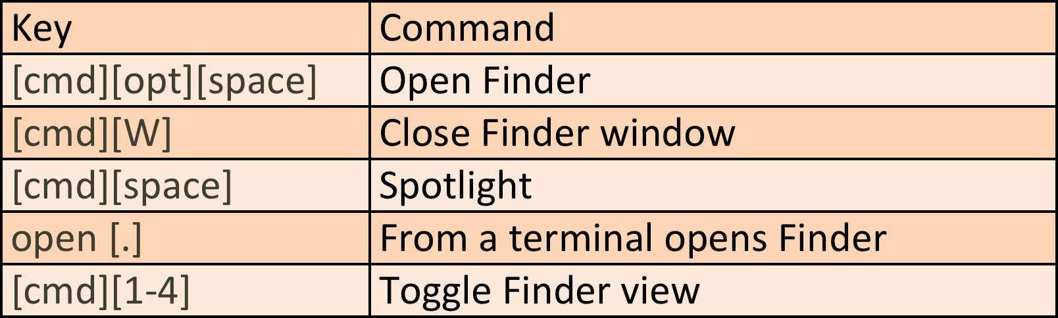
Finder
[cmd][shift][F] | All My Files
[cmd][shift][O] | Documents
[cmd][shift][D] | Desktop
[cmd][shift][H] | Home
[cmd][shift][C] | Computer
[cmd][shift][A] | Applications
[cmd][shift][U] | Utilities
[cmd][option][L] | Downloads
[cmd][[]] | Directory back/forward
[cmd][^v] | Move up/down directories
[cmd][<>] | Toggle folder trees
[cmd][O|v] | Open file/folders

Slide 12
Miscellaneous
Key | Command
[cmd][shift][3] | Screen shot
[cmd][shift][4] | Screen shot part of screen (hit space after for window under mouse)
[cmd][option][d] | Hide Dock
[cmd][option][shift][V] | Paste without formatting
[cmd][ctrl][n] | Add highlighted files to a folder
[cmd][click] | On icon to open it in finder
[cmd][option] | Open a file in specific app while dragging the file onto the Dock
[ctrl][option][cmd][6] | Tidy up icons
[opt][delete] | Delete entire word to the left
[cmd][?] | (cmd-shift-/) Quickly find any menu item and launch it
[shift][option] | Incremental adjustment of [screen/key]brightness/volume
[cmd][alt][escape] | Force quit any open applications
[cmd][,] | Open preferences for any application

Slide 13
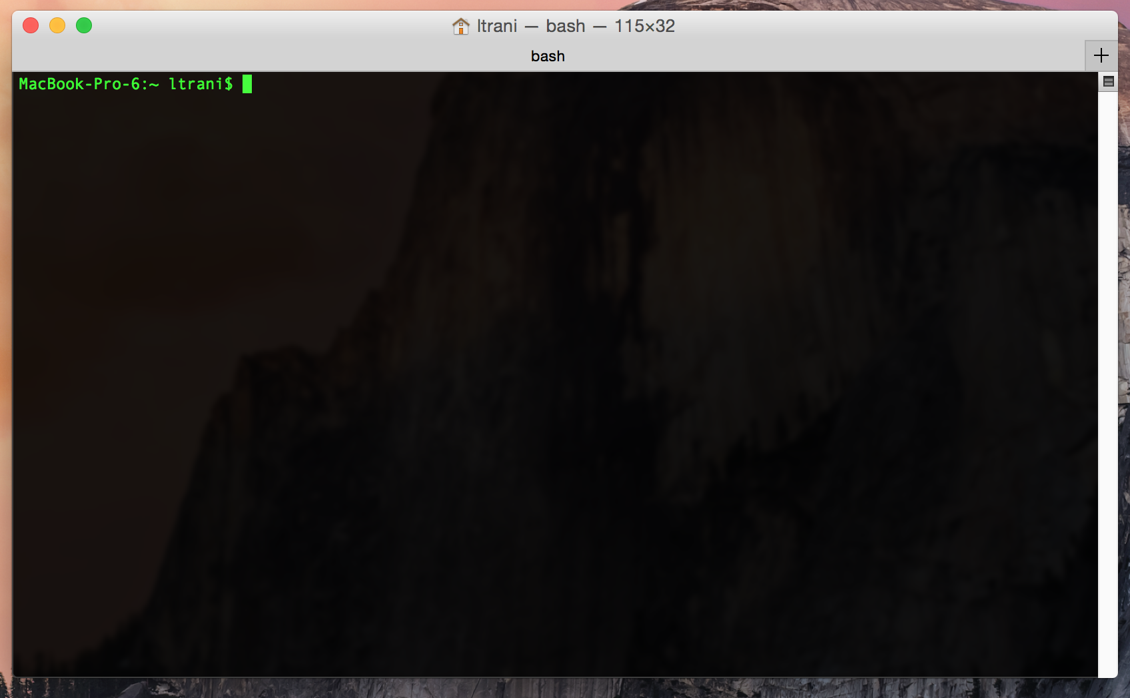
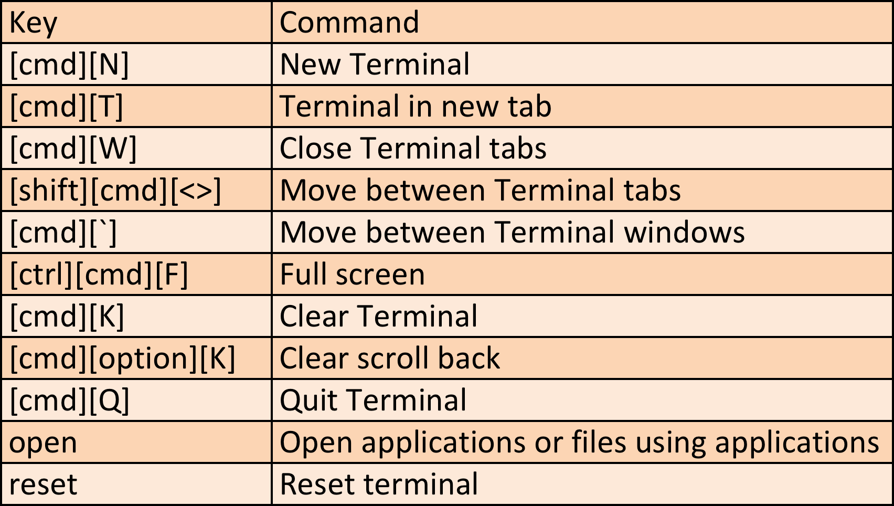
Unix Terminal

Slide 14
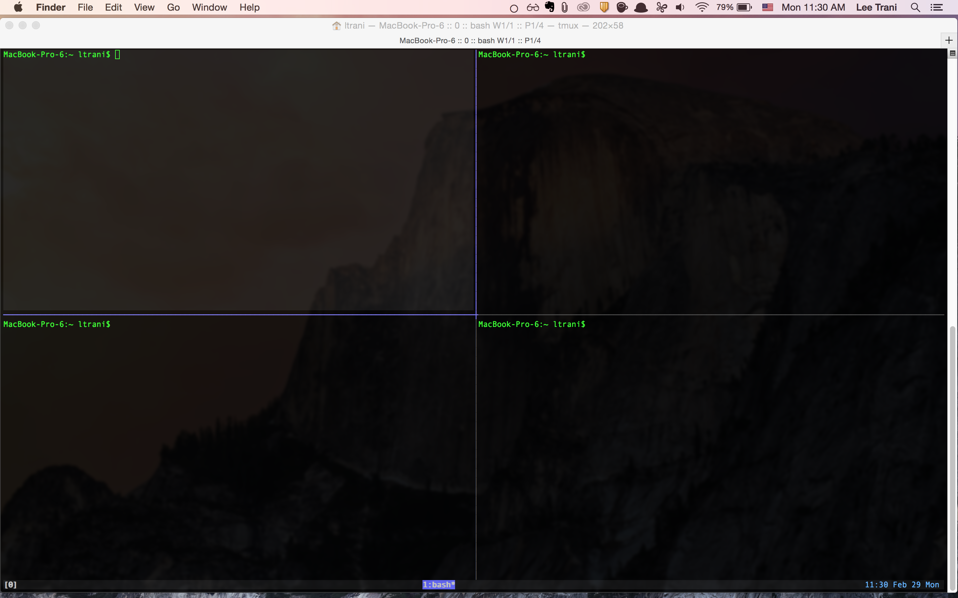
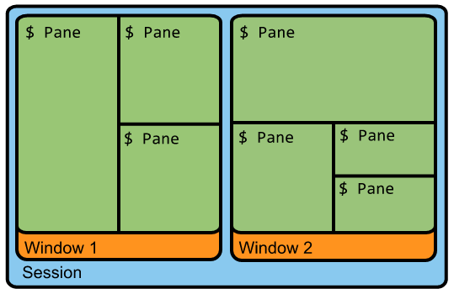
TMUX - A Cool Terminal Multiplexer
tmux is a terminal multiplexer it lets you switch easily between several programs in one terminal, detach them (they keep running in the background) and reattach them to a different terminal.

Slide 15
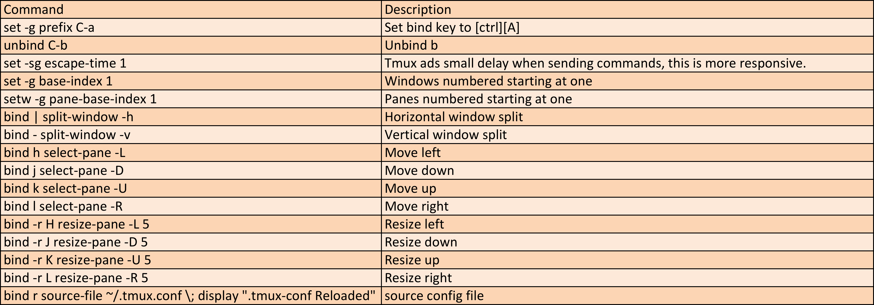
.tmux.conf
[ctrl][B] is the default binding key for tmux.
A more intuitive binding key is [ctrl][A]
.tmux.conf – Config file for tmux

Slide 16
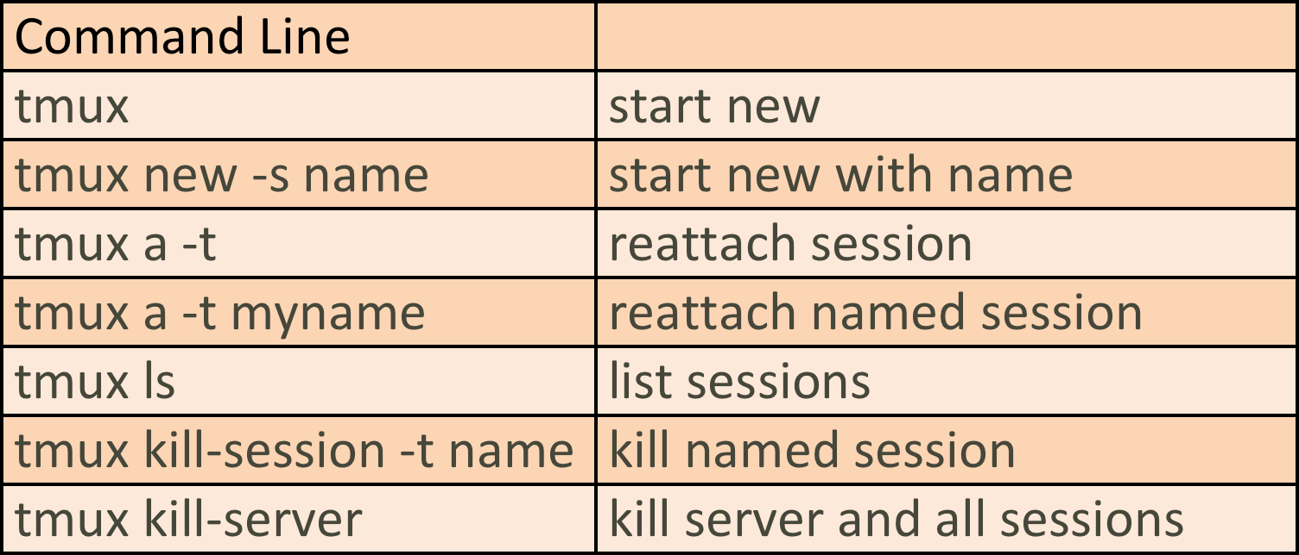
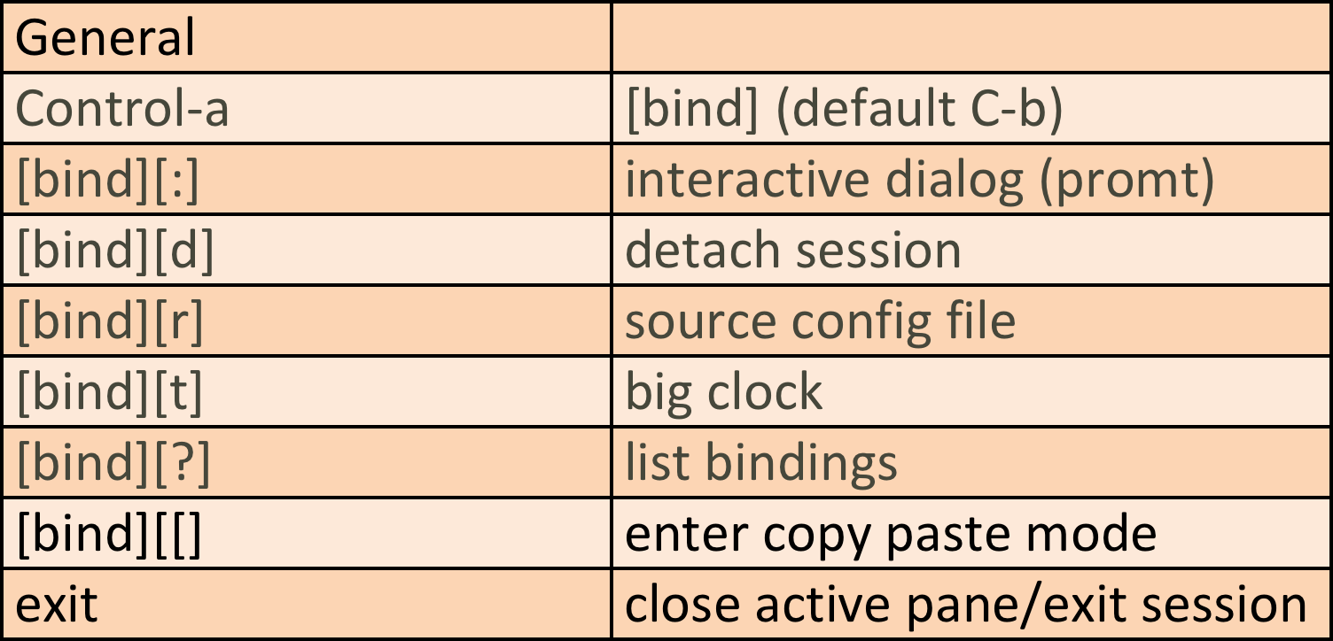
Basic TMUX Commands

Slide 17
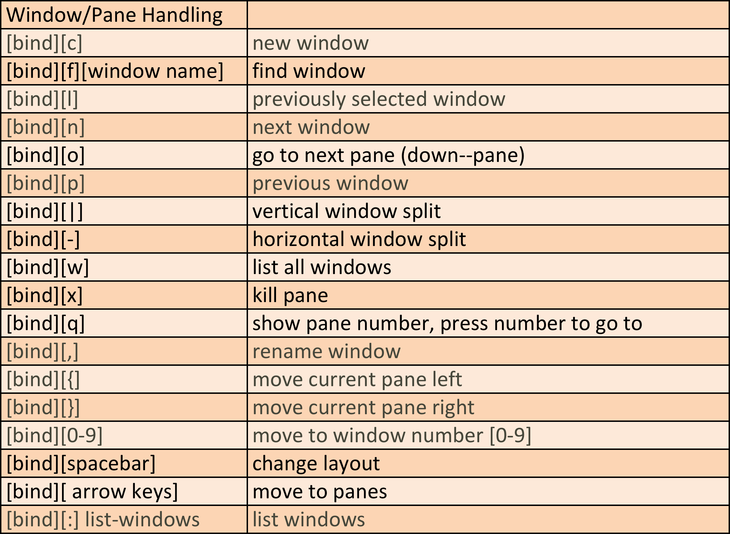
Basic TMUX Commands

Slide 18
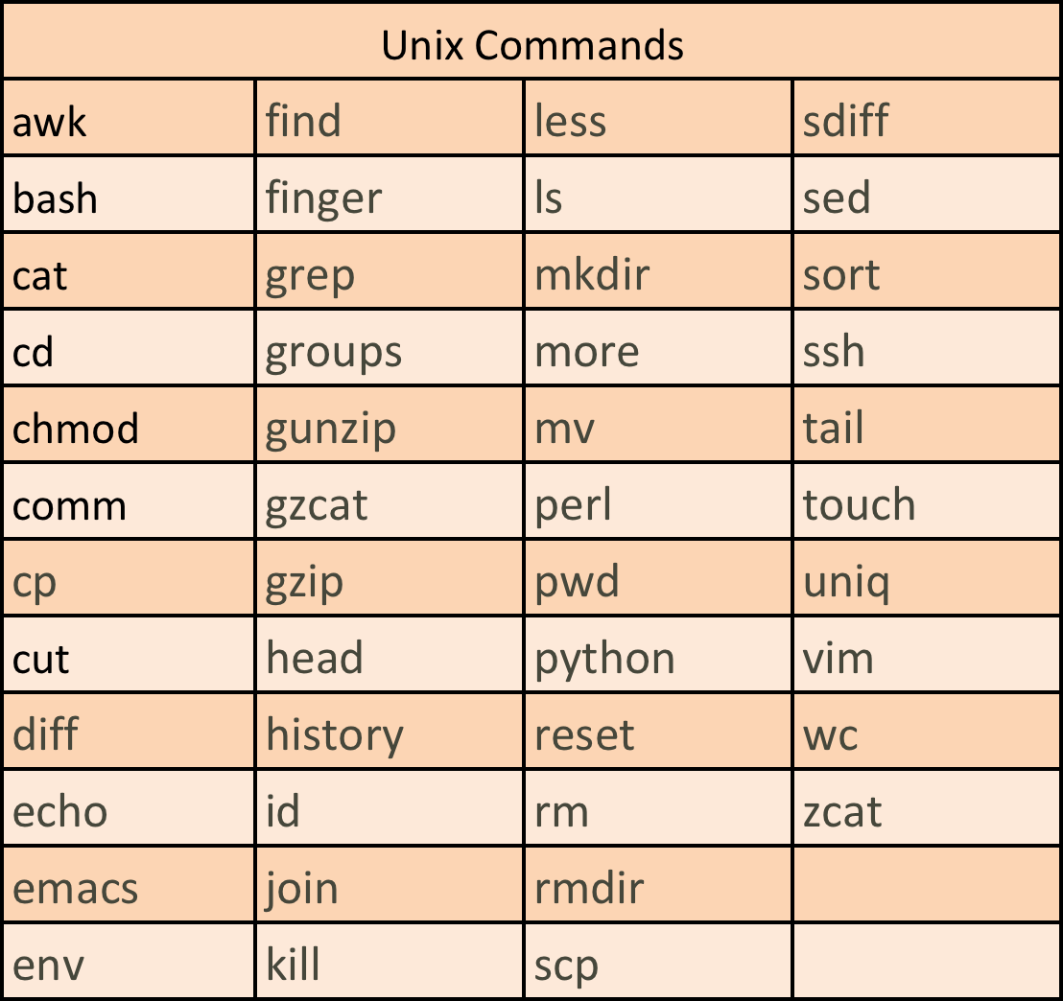
Common Unix Commands

Slide 19
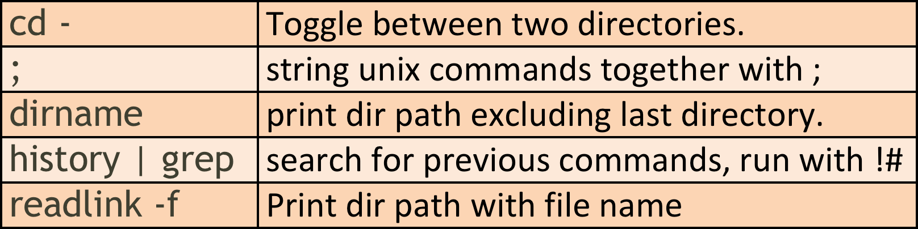
Miscellaneous

Slide 20
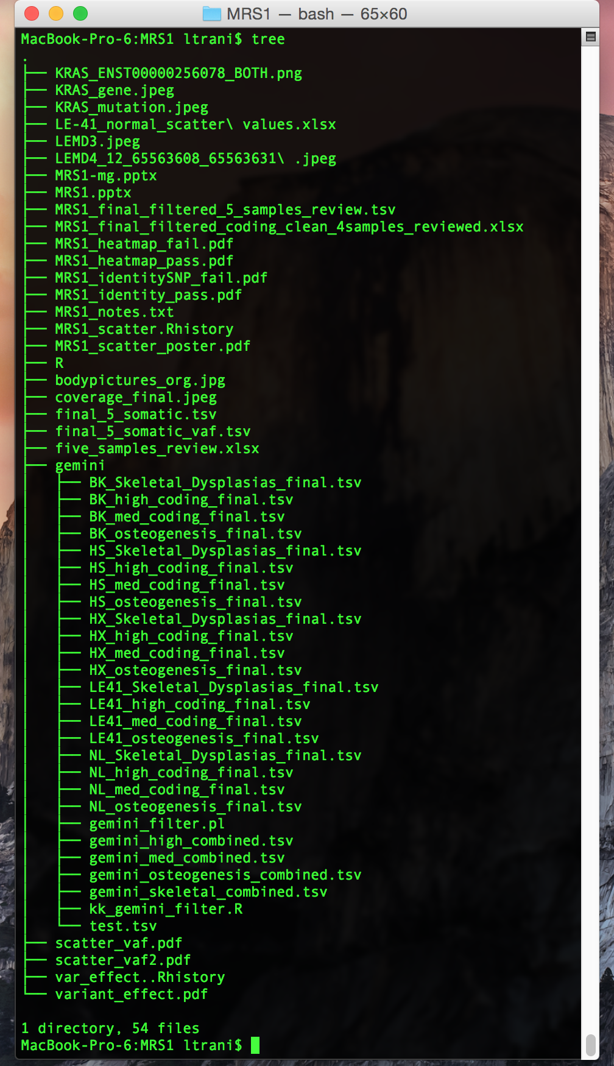
tree
tree - lists the contents of directories in a
tree-like format.
brew install tree
-a -All files are printed. By default tree
does not print hidden files.
-d - List directories only.
-f - Prints the full path prefix for each file.

Slide 21
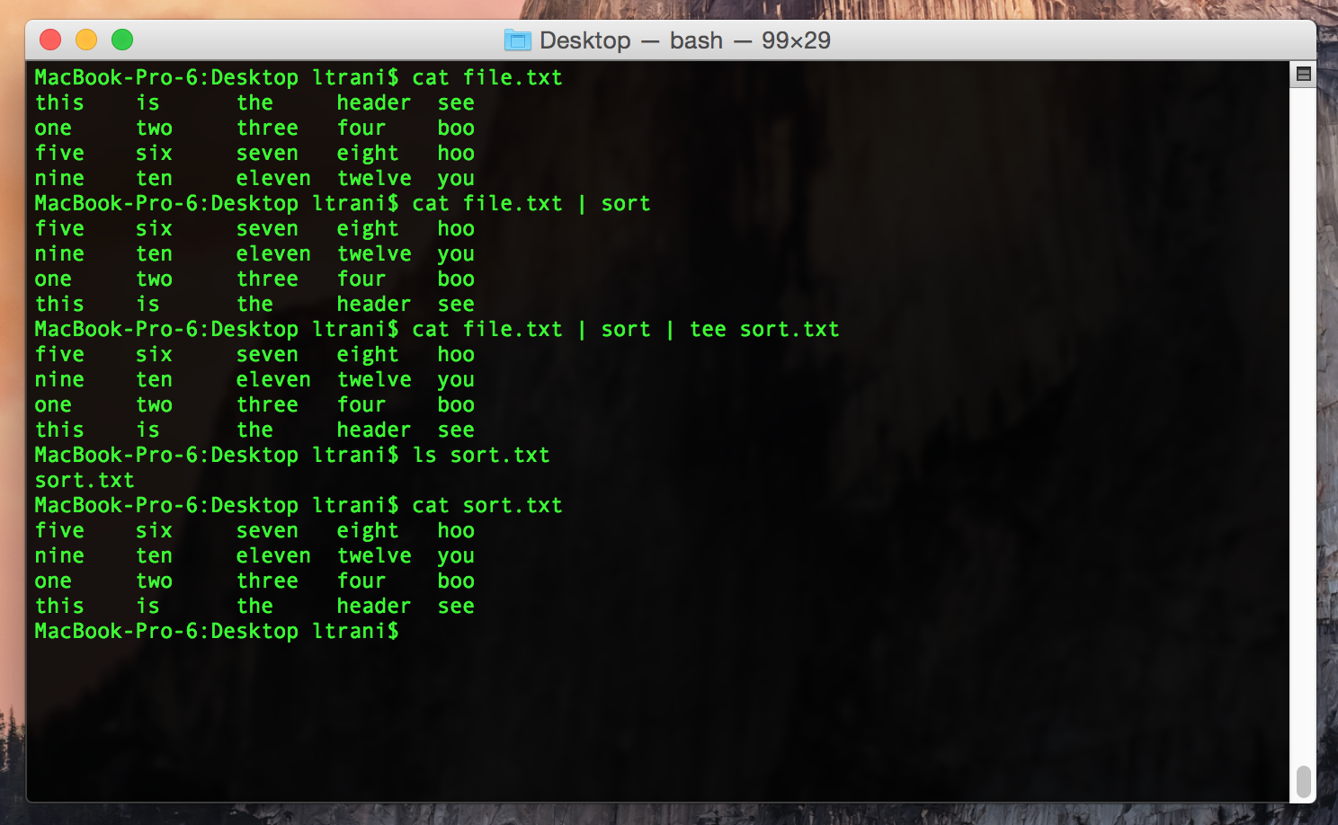
tee
Reads from standard input, and writes to standard output and to files. Tee copies data from standard input to each FILE, and also to standard output. In effect, tee duplicates its input, routing it to multiple outputs at once.
-a, -append

Slide 22
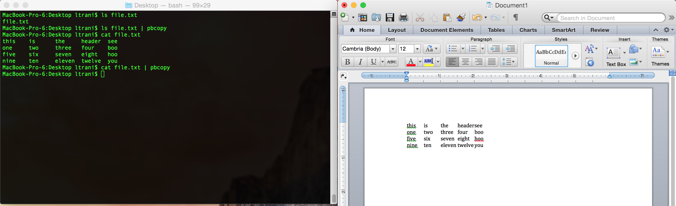
Copy Paste From Command Line
Macbook: pbcopy/pbpaste – stores in [cmd][v]
Unix: xclip – accessible with middle mouse click/clipboard
xclip = alias xc='xclip -selection clipboard’ – stores ctrl v in unix

Slide 23
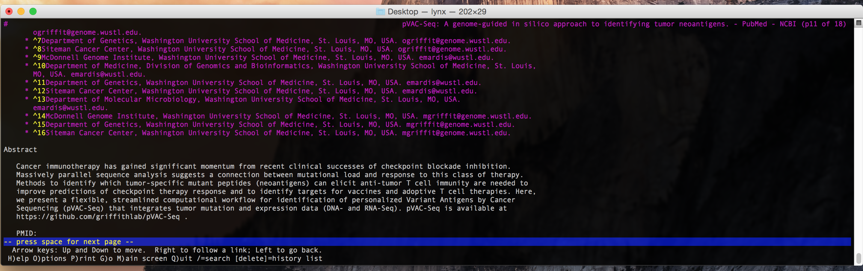
lynx
Lynx is one of the most popular web browsers for command-line interfaces. Lynx was designed to display plain ASCII text on simple terminals, without including any multimedia content. This lets you view hypertext documents and navigate through lists of links with just your keyboard. You can't use a mouse, display graphical images, or play sound files.
Notes:
Use alfred pubmed search for Obi and Malachi, pull it up with lynx

Slide 24
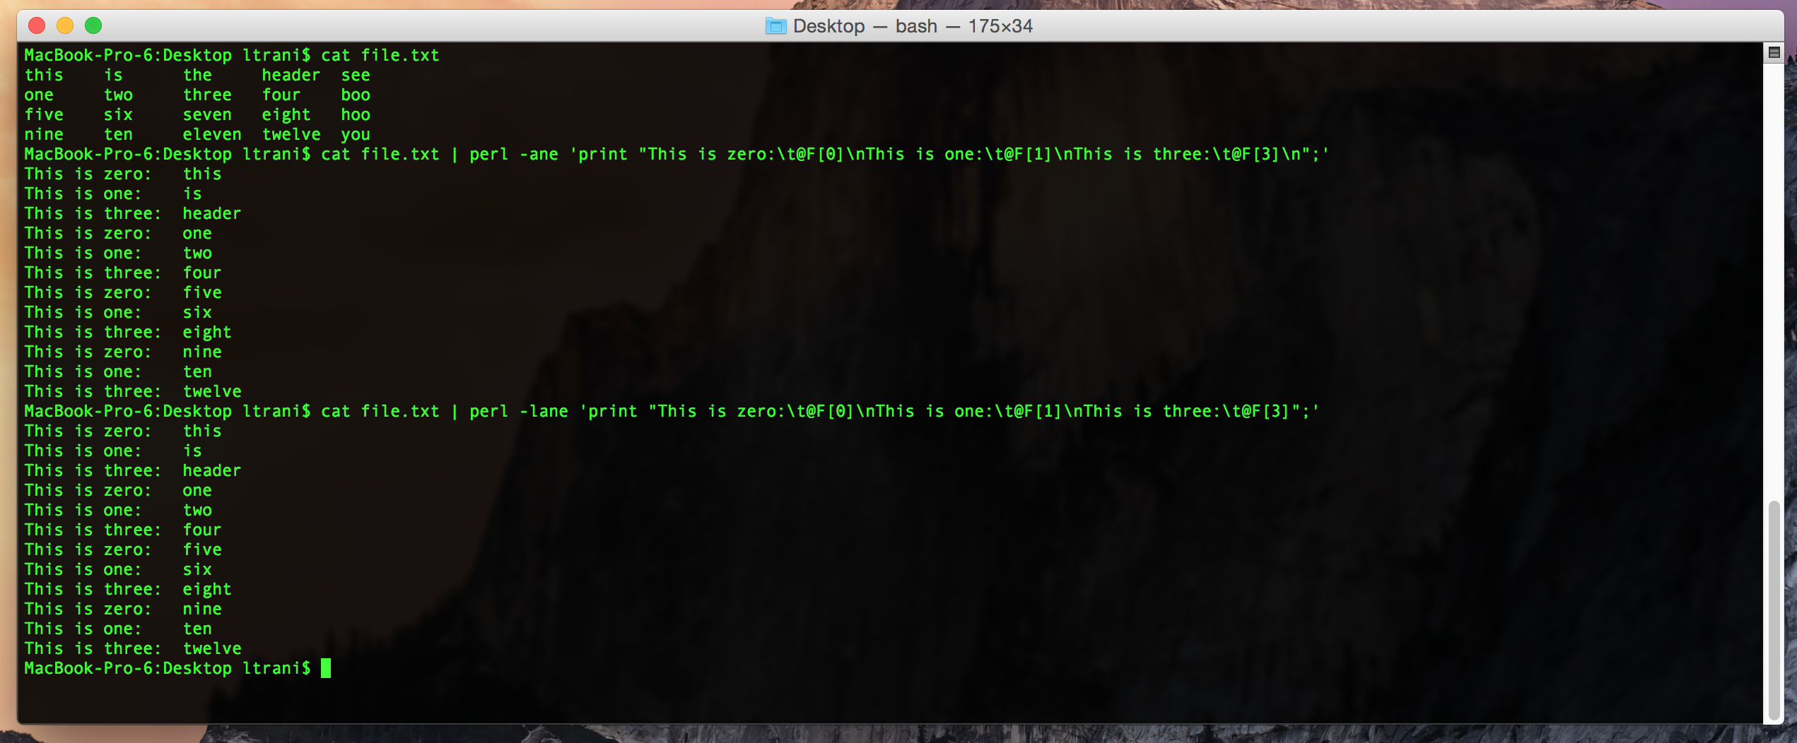
Command Line Perl – Autosplit, Add to Array
-a - turns on autosplit mode – perl will automatically split input lines on whitespace into the @F array.
-F - is used in conjunction with -a, to choose the delimiter on which to split lines.
-l - Smart newline processing. Normally, perl hands you entire lines, including a trailing newline. This will strip the trailing newline off of any lines read, and automatically add a newline to anything you print.

Slide 25
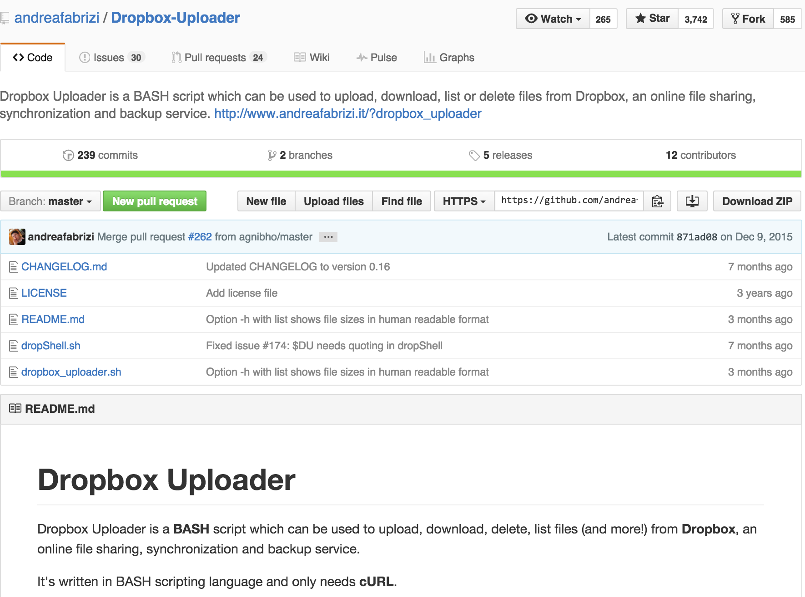
Dropbox-Uploader

Slide 26
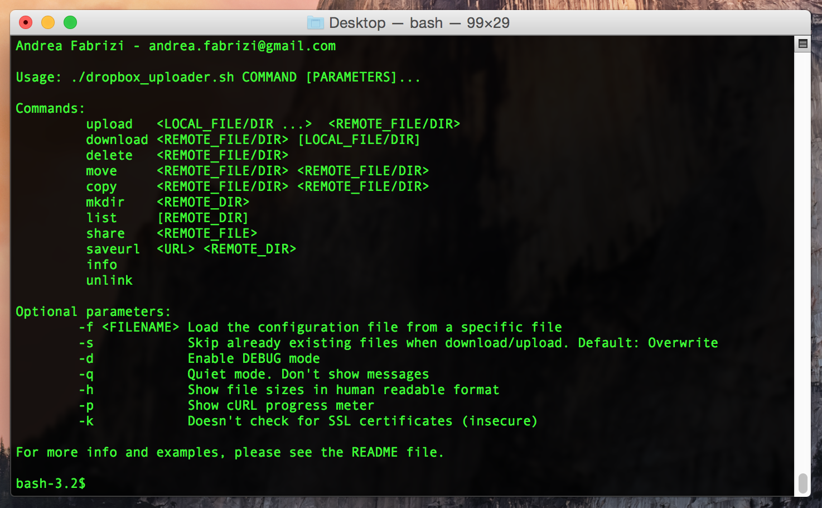
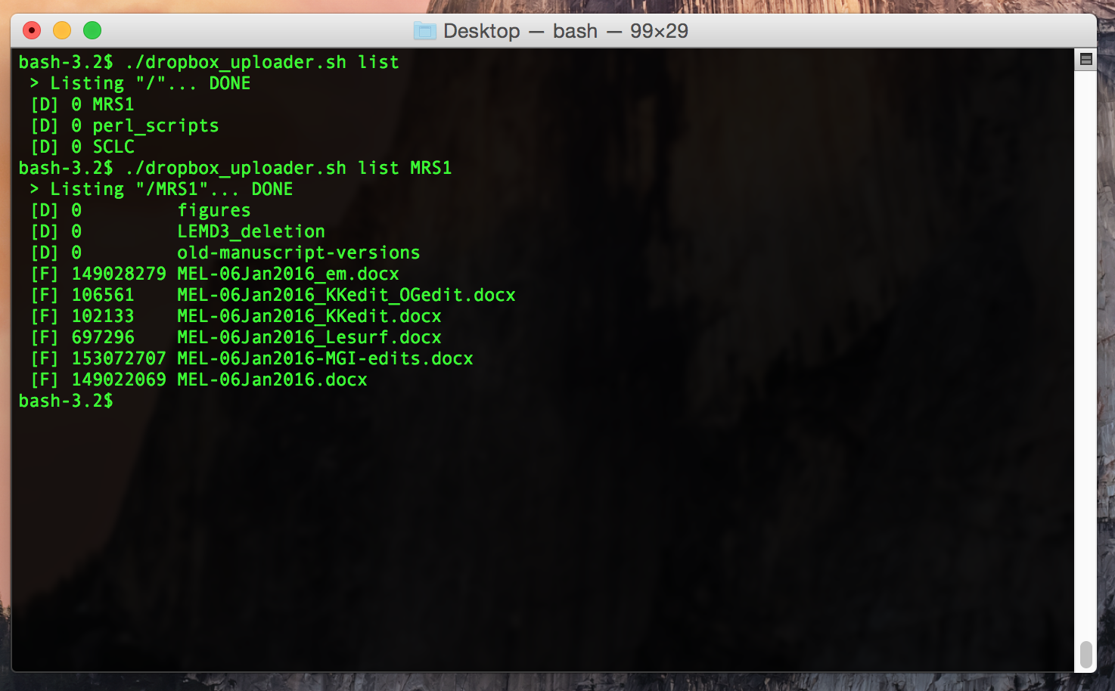
Dropbox-Uploader

Slide 27
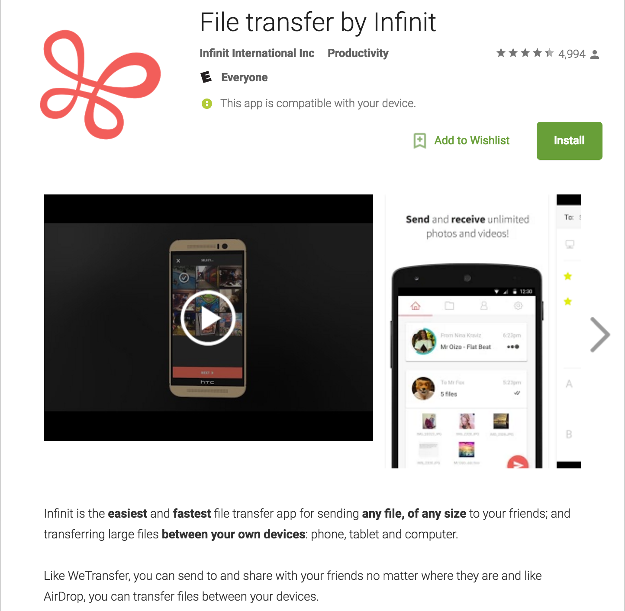
Infinit

Slide 28
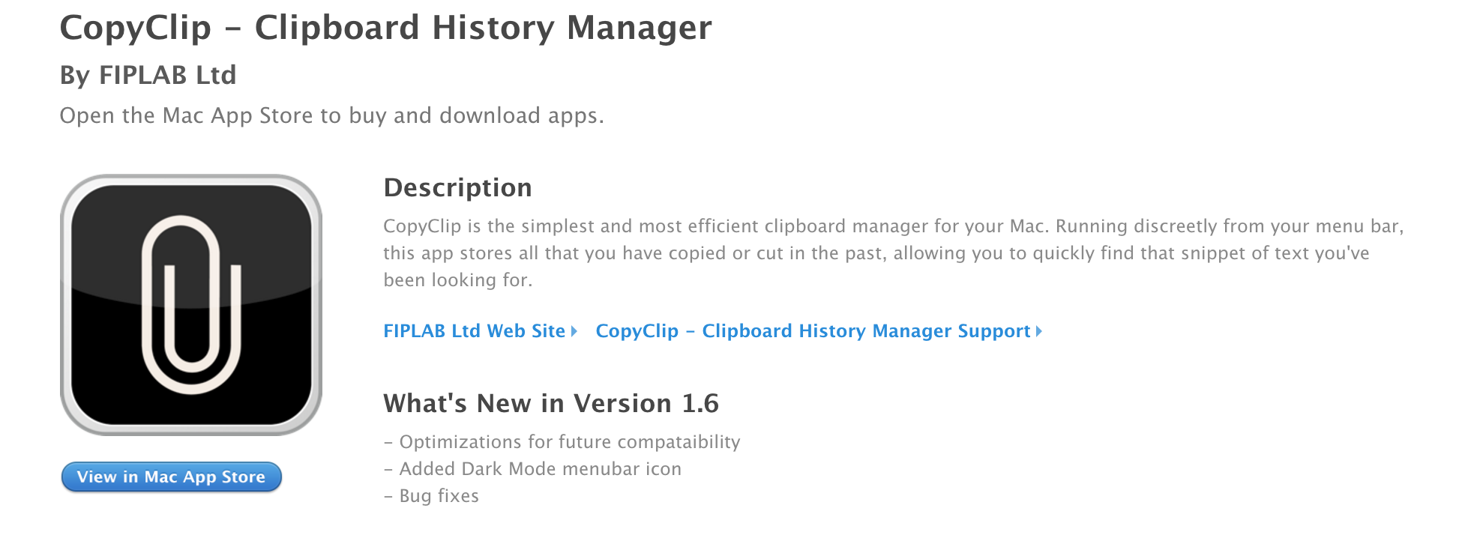
CopyClip

Slide 29
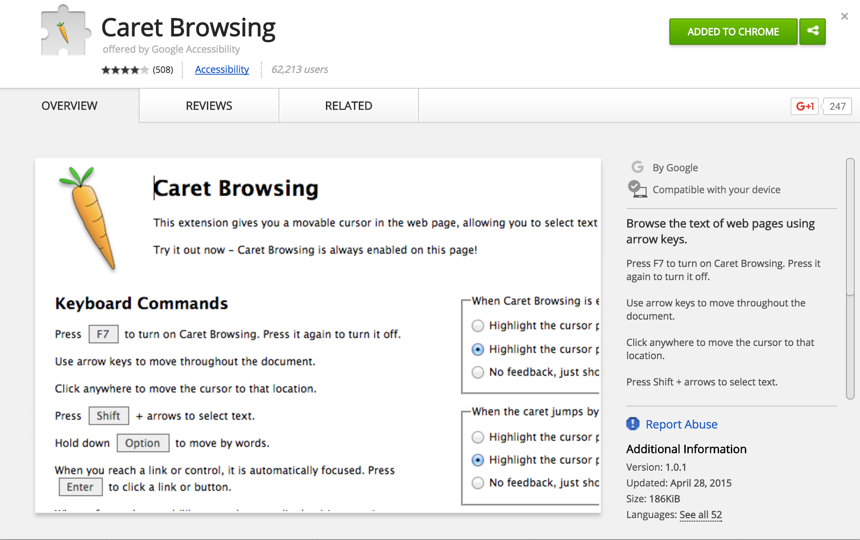
Caret Browsing

Slide 30
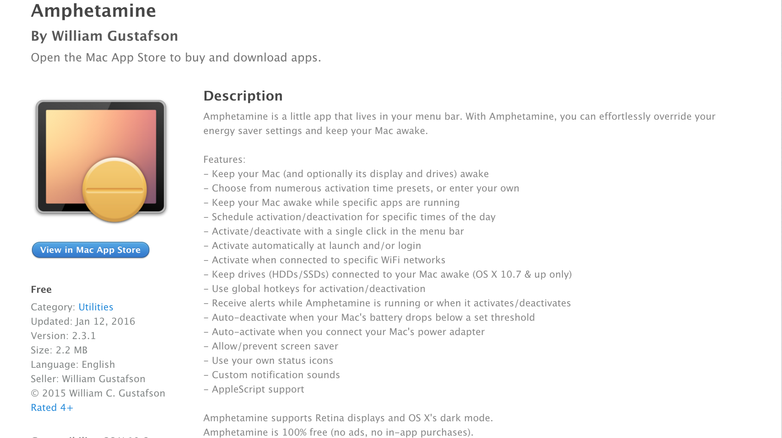
Amphetamine

Slide 31
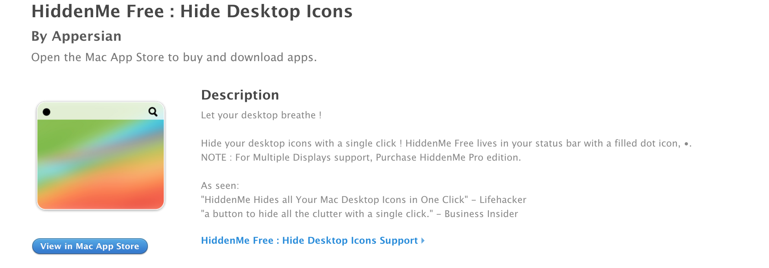
HiddenMe

